Slide 1
FOURIER open label extension Slidedeck
Primäranalyse: Slides 2-19
Analyse „low LDL-C“: Slides 20-38

Slide 2
Long-Term Evolocumab in Patients with
Established Atherosclerotic Cardiovascular Disease:
Primary Results of the
FOURIER-OLE (Open-Label Extension) Studies
Michelle L. O’Donoghue, Robert P. Giugliano, Sarina Trindade, Dan Atar, Anthony Keech, Julia Kuder, KyungAh Im, Sabina Murphy, Jose H. Flores-Arredondo, J. Antonio G. López, Mary Elliott-Davey, Bei Wang, Maria Laura Monsalvo,
Siddique Abbasi, Marc S. Sabatine
On Behalf of the FOURIER-OLE Investigators
SC-AT-AMG145-01196 Aug 2022
This study was funded by Amgen Inc.

Slide 3
Background
In the FOURIER trial, 27,564 patients with stable ASCVD were randomized to the PCSK9 inhibitor evolocumab vs. placebo
Evolocumab reduced the risk of MACE, but there was no observed effect on CV mortality
However, the median follow-up was only 2.2 years
O’Donoghue ML et al. ESC 2022

Slide 4
Background (2)
Pivotal statin trials had median follow-up of 4-5 years and demonstrated both a lag effect (clinical benefit grew over time) and legacy effect (clinical benefit persisted in extended follow-up after the parent trial ended)
Thus, very long-term data on safety and efficacy of LDL-C lowering with PCSK9 inhibition are needed
O’Donoghue ML et al. ESC 2022

Slide 5

Evolocumab:
Evidence of Lag Effect for MACE
CV death, MI, Stroke
Months from Randomization
Sabatine MS et al. NEJM 2017;376:1713-22

Slide 6
Study Schema
‑ OLE
Evolocumab
q2 or q4 wks
Open-Label Evolocumab
q2 or q4 wks
Patients with stable ASCVD and LDL-C ≥70 mg/dl (~1.8mM) or non-HDL-C ≥100 mg/dl (~2.6mM)
on optimized statin Rx
R
Matching
placebo
Parent FOURIER Trial
Median follow-up 2.2 yrs
N=27,564
FOURIER OLE Program
Median follow-up 5.0 yrs
N=6635
US & Eastern Europe: NCT02867813
Western Europe: NCT03080935
O’Donoghue ML et al. ESC 2022

Slide 7
Methods
‑ OLE
Primary endpoint was incidence of adverse events
MACE were prespecified exploratory endpoints and were reviewed by the TIMI Study Group Clinical Events Committee
Safety evaluations included all patients in FOURIER-OLE who received ≥1 dose of study drug and for whom post-dose data were available. Patients were censored for safety analyses 30 days following permanent drug discontinuation or end-of-study (whichever was earlier).
Analyses for major adverse cardiovascular events were conducted on an intention-to-treat basis and stratified by original treatment assignment at randomization
O’Donoghue ML et al. ESC 2022

Slide 8
Baseline Characteristics of
OLE Population at Randomization
‑ OLE
 |  | Initial allocation in parent FOURIER trial
 |  | Placebo (N=3280) | Evolocumab (N=3355)
Demographics | Age (mean, years) | 62 | 62
 | Male sex (%) | 76 | 77
 | White race (%) | 96 | 95
Region (%) | Europe | 66 | 67
 | United States | 34 | 33
Type of athero (%) | Myocardial infarction | 84 | 84
 | Non-hemorrhagic stroke | 16 | 16
 | Peripheral artery disease | 14 | 15
CV risk factors (%) | Hypertension | 85 | 82
 | Diabetes mellitus | 35 | 33
 | Current cigarette use | 27 | 26
Meds at time of enrollment in FOURIER (%) | High-intensity statin use | 76 | 77
 | Ezetimibe | 5.5 | 6.0
LDL-C at randomization (median, IQR) | mmol/L | 2.4 (2.1-2.8) | 2.4 (2.1-2.8)
 | mg/dl | 91 (80-109) | 92 (80-108)
O’Donoghue ML et al. ESC 2022
All comparisons P>0.05

Slide 9
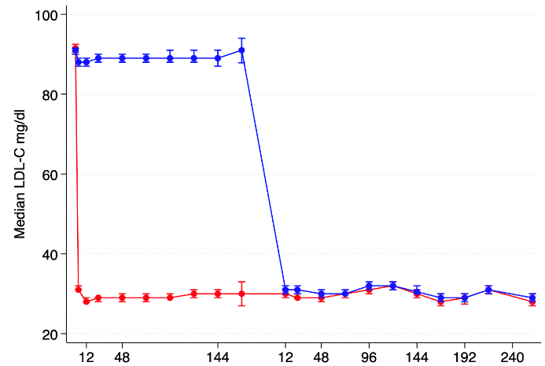
Effect on LDL-C
‑ OLE
Placebo transition to evolocumab
Parent FOURIER
Evolocumab vs placebo
FOURIER-OLE
Open-label Evolocumab
2.5
2.0
Randomized to placebo
Randomized to evolocumab
Median LDL cholesterol (95% CI, mmol/L)
1.5
1.0
0.5
0
Weeks
O’Donoghue ML et al. ESC 2022

Slide 10
Effect on LDL-C
‑ OLE
Placebo transition to evolocumab
Parent FOURIER
Evolocumab vs placebo
FOURIER-OLE
Open-label Evolocumab
2.5
2.0
Randomized to placebo
Randomized to evolocumab
Median LDL cholesterol (95% CI, mmol/L)
1.5
Median LDL-C at Week 260:
0.75 mmol/L (IQR 0.44-1.29)
29 mg/dl (IQR 17-50)
1.0
0.5
0
Weeks
O’Donoghue ML et al. ESC 2022

Slide 11
Long-Term Safety
‑ OLE
SERIOUS ADVERSE EVENTS
INJECTION SITE REACTIONS
DRUG-RELATED ALLERGIC RXN
Annualized IR
Annualized IR
Annualized IR
MUSCLE-RELATED EVENT
NEW ONSET DIABETES
HEMORRHAGIC STROKE
Annualized IR
Annualized IR
Annualized IR
Placebo Phase FOURIER
Evolocumab Phase FOURIER
Evolocumab Phase FOURIER & OLE
O’Donoghue ML et al. ESC 2022

Slide 12
Efficacy during FOURIER-OLE
‑ OLE
20%
Primary Endpoint: CV death, MI, stroke, unstable angina or coronary revascularization
17.5%
15% reduction
HR 0.85
(95% CI 0.75-0.96)
P=0.008
15.4%
10%
Placebo Evolocumab
Evolocumab Evolocumab
0%
0
1
2
3
4
5
Years in OLE
Number at risk:
Placebo-Evolocumab
3280
3055
2876
2716
2573
1706
Evolocumab-Evolocumab
3355
3186
3033
2890
2716
1754
O’Donoghue ML et al. ESC 2022

Slide 13
Efficacy during FOURIER-OLE
‑ OLE
15%
Key Secondary Endpoint:
CV death, MI or stroke
11.9%
HR 0.80
(95% CI 0.68-0.93)
P=0.003
20% reduction
10%
9.7%
5%
Placebo Evolocumab
Evolocumab Evolocumab
0%
Number at risk:
0
1
2
3
4
5
Years in OLE
Placebo-Evolocumab
3280
3128
2987
2857
2729
1809
Evolocumab-Evolocumab
3355
3247
3123
3012
2870
1862
O’Donoghue ML et al. ESC 2022

Slide 14
Efficacy during FOURIER-OLE Time Period
‑ OLE
5%
CV death
4.45%
HR 0.77
(95% CI 0.60-0.99)
P=0.04
23% reduction
4%
3.32%
3%
2%
1%
Placebo Evolocumab
Evolocumab Evolocumab
0%
0
1
2
3
4
5
Years in OLE
Number at risk:
Placebo-Evolocumab
3280
3223
3155
3081
2991
2049
Evolocumab-Evolocumab
3355
3314
3244
3173
3080
2069
O’Donoghue ML et al. ESC 2022

Slide 15
Efficacy during FOURIER & FOURIER-OLE
‑ OLE
FOURIER Primary Endpoint
30%
Parent FOURIER
Median 2.2 yrs
FOURIER-OLE
Median 5 yrs
20%
CV death, MI, stroke, UA, or coronary revascularization (%)
10%
Placebo Evolocumab
Evolocumab Evolocumab
0%
0
1
2
3
4
5
6
7
8
Years
Number at risk:
Placebo-Evolocumab
13780
12822
8467
3260
2654
2526
2372
1498
189
Evolocumab-Evolocumab
13784
12937
8683
3389
2814
2699
2550
1569
165
O’Donoghue ML et al. ESC 2022

Slide 16
Efficacy during FOURIER & FOURIER-OLE
‑ OLE
Parent FOURIER
Median 2.2 yrs
FOURIER-OLE
Median 5 yrs
FOURIER Key Secondary Endpoint
20%
CV death, MI or stroke (%)
10%
Placebo Evolocumab
Evolocumab Evolocumab
0%
0
1
2
3
4
5
6
7
8
Years
Number at risk:
Placebo-Evolocumab
13780
13140
8846
3470
2861
2757
2621
1664
216
Evolocumab-Evolocumab
13784
13240
9051
3617
3046
2946
2810
1746
185
O’Donoghue ML et al. ESC 2022

Slide 17
Efficacy during FOURIER & FOURIER-OLE
‑ OLE
Parent FOURIER
Median 2.2 yrs
FOURIER-OLE
Median 5 yrs
CV Death
7%
6%
5%
4%
CV death (%)
3%
2%
Placebo Evolocumab
1%
Evolocumab Evolocumab
0%
0
1
2
3
4
5
6
7
8
Years
Number at risk:
Placebo-Evolocumab
13780
13590
9399
3753
3167
3098
2996
1965
268
Evolocumab-Evolocumab
13784
13598
9464
3826
3270
3204
3109
1988
237
O’Donoghue ML et al. ESC 2022

Slide 18
MACE by Year of Study
CV death, MI, stroke, hosp for UA,
or coronary revascularization
CV death, MI or stroke
LDL-C ∆
between arms
Hazard ratio (95% CI)
Hazard ratio (95% CI)
1.6 mM
(62 mg/dl)
Year 1
0.88 (0.80-0.97)
Lag
0.84 (0.74-0.96)
FOURIER
Lag
Year 2+
0.81 (0.73-0.89)
0.75 (0.66-0.85)
Year 1
0.71 (0.57-0.89)
Legacy
0.63 (0.47-0.86)
Legacy
Year 2
0.81 (0.63-1.04)
0.85 (0.62-1.15)
0.0 mM
Year 3
0.80 (0.62-1.03)
FOURIER-OLE
0.73 (0.52-1.01)
Year 4
1.21 (0.94-1.56)
1.11 (0.81-1.52)
Year 5+
1.06 (0.80-1.40)
0.90 (0.64-1.28)
0.5
0.6
0.8
1.0
1.2
1.6
2.0
0.5
0.6
0.8
1.0
1.2
1.6
2.0
Favors evolocumab-evolocumab
Favors placebo-evolocumab
Favors evolocumab-evolocumab
Favors placebo-evolocumab
O’Donoghue ML et al. ESC 2022

Slide 19
Summary
‑ OLE
Long-term use of evolocumab with median follow-up of more than 7 years appears both safe and well-tolerated
Earlier initiation of evolocumab is associated with continued accrual of cardiovascular benefit, including cardiovascular mortality, over the next several years
These findings argue for early initiation of a marked and sustained LDL-C reduction to maximize clinical benefit
O’Donoghue ML et al. ESC 2022

Slide 20

Association Between Achieved LDL-Cholesterol and Long-term Cardiovascular and Safety Outcomes:
An Analysis of the FOURIER and FOURIER-OLE Studies
Prakriti Gaba MD, Michelle L. O’Donoghue MD MPH, Jeong-Gun Park, PhD,
Stephen D. Wiviott MD, Dan Atar MD, Anthony Keech MBBS, Julia F. Kuder MA,
KyungAh Im PhD, Sabina A. Murphy MPH, Jose H. Flores-Arredondo MD,
J. Antonio G. López MD, Mary Elliott-Davey MSc, Bei Wang PhD, Maria Laura Monsalvo MD, Siddique Abbasi MD, Robert P. Giugliano, MD SM, Marc S. Sabatine, MD MPH
SC-AT-AMG145-01216 Nov 2022

Slide 21
Disclosures
This study was funded by Amgen Inc.

Slide 22
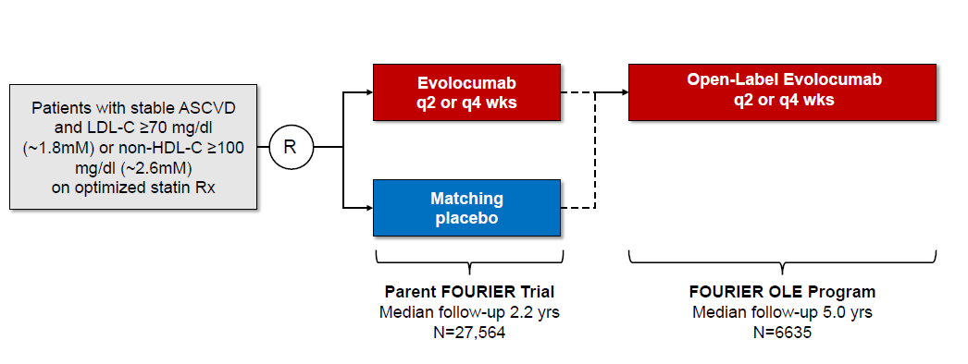
Study Schema: FOURIER and FOURIER-OLE
Sabatine et al. NEJM 2017; 376: 1713-1722.
O’Donoghue et al. Circulation 2022; 146:1109-1119.

Slide 23

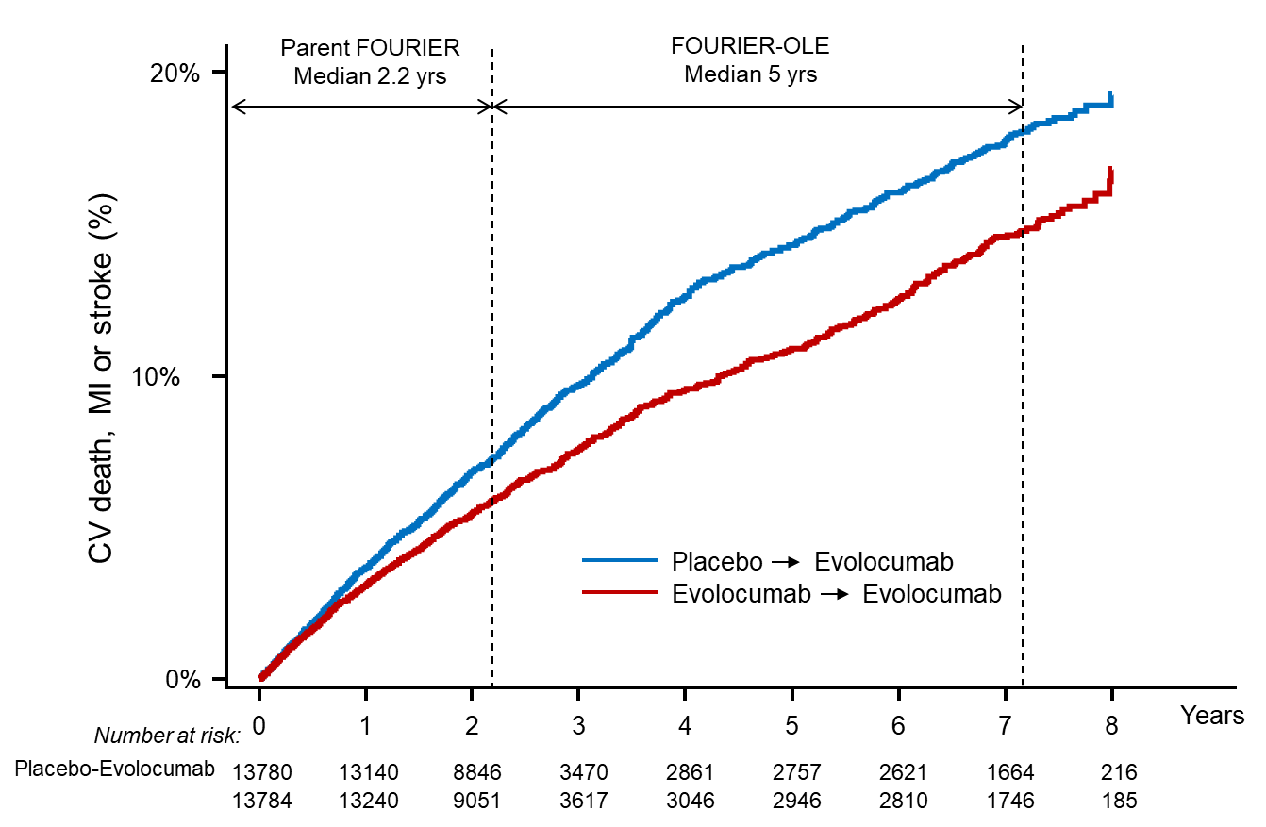
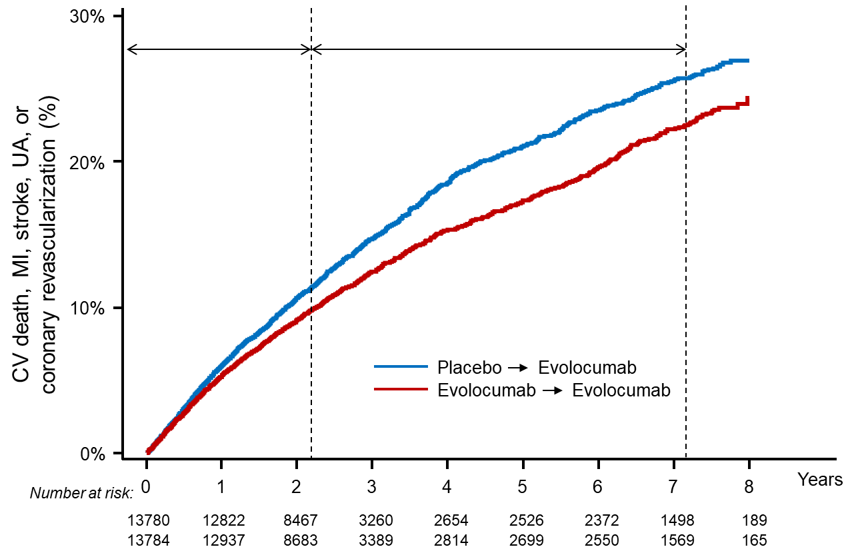

Results of FOURIER and FOURIER-OLE – CV Outcomes
Primary Efficacy Endpoint
Key Secondary Efficacy Endpoint
HR 0.85 [0.80-0.91]
HR 0.80 [0.74-0.87]
O’Donoghue et al. Circulation 2022; 146:1109-1119.

Slide 24
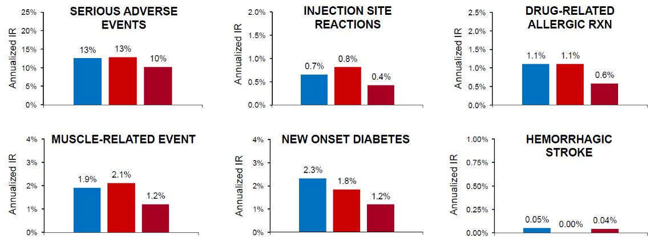
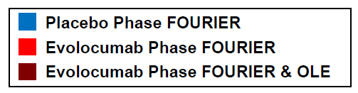
Results of FOURIER-OLE - Safety
O’Donoghue et al. Circulation 2022; 146:1109-1119.

Slide 25
Evidence Gap
The optimal achieved LDL-C level with regards to cardiovascular and safety outcomes in the long term remains unclear.
Gaba P et al. AHA 2022

Slide 26
Objective
To explore the relationship between achieved LDL-C levels and the occurrence of long-term adverse cardiovascular and safety outcomes, down to very low (<20 mg/dL) achieved LDL-C levels.
Gaba P et al. AHA 2022

Slide 27
Methods
Patients divided into 6 categories based on achieved LDL-C: <20, 20-<40, 40-<55, 55-<70, 70-<100, and ≥100 mg/dL
CV outcomes
  Primary: CV death, MI, stroke, coronary revascularization, or hospitalization for unstable angina
  Key secondary: CV death, MI, or stroke
Safety outcomes
  Serious adverse events, muscle-related events, new-onset diabetes mellitus, cataract-related adverse events, neurocognitive events, hemorrhagic stroke, malignancy, and non-CV death
Gaba P et al. AHA 2022

Slide 28
Methods (cont’d)
Examined trends in baseline characteristics
Annualized incidence rates and 95% confidence intervals were calculated for all cardiovascular and safety outcomes
Multivariable models adjusted for baseline characteristics associated with achieved LDL-C, including age, BMI, sex, race, current smoker, prior MI, prior non-hemorrhagic stroke, history of diabetes, history of peripheral arterial disease, high-intensity statin use, ezetimibe use, and participation in OLE.
Gaba P et al. AHA 2022

Slide 29
Cohort & Follow-Up
26,384 patients with achieved LDL-C levels in FOURIER and/or FOURIER-OLE
19,960 patients in FOURIER alone with a median follow-up 2.0 years
6,429 patients also participated in FOURIER-OLE with median follow up 4.9 years
Including FOURIER & FOURIER-OLE, maximum follow-up 8.6 years
Gaba P et al. AHA 2022

Slide 30
Achieved LDL-C Categories
LDL-C Category:
Gaba P et al. AHA 2022

Slide 31
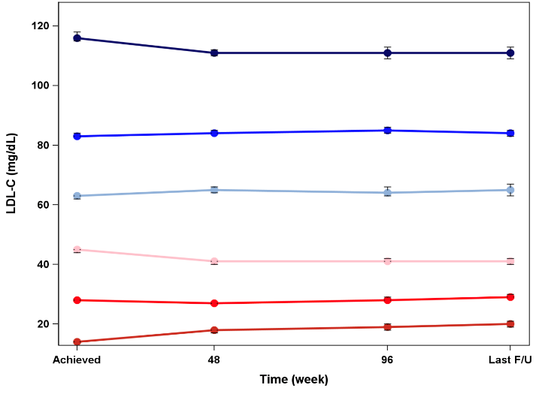
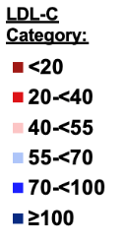
Achieved LDL-C Over Time
Gaba P et al. AHA 2022

Slide 32
Baseline Characteristics by Achieved LDL-C
 | Achieved LDL-C level (mg/dL)
 | <20 | 20-<40 | 40-<55 | 55-<70 | 70-<100 | ≥100 | P_{trend}
Age, mean (SD), yrs | 63.5±8.7 | 63.2±8.8 | 61.6±8.9 | 62.0±9.3 | 62.7±9.0 | 61.2±9.0 | <0.0001
Male | 83.7% | 78.9% | 71.4% | 71.4% | 74.6% | 70.7% | <0.0001
BMI, mean (SD), kg/m² | 28.4±4.4 | 29.1±4.7 | 30.3±5.7 | 30.1±5.7 | 29.4±5.3 | 29.5±5.1 | <0.0001
White race | 84.0% | 87.4% | 87.0% | 82.2% | 82.5% | 86.1% | 0.0003
Prior MI | 82.2% | 81.6% | 81.0% | 79.3% | 81.7% | 79.9% | 0.037
Non-hemorrhagic CVA | 18.9% | 18.3% | 18.8% | 19.7% | 19.8% | 20.8% | 0.0019
Diabetes mellitus | 34.9% | 33.9% | 40.6% | 42.0% | 35.8% | 35.6% | 0.051
Current smoker | 26.6% | 26.2% | 28.0% | 28.9% | 28.7% | 32.6% | <0.0001
High-intensity statin | 65.8% | 69.1% | 72.5% | 69.6% | 68.2% | 71.4% | 0.0043
Baseline LDL-C, median (IQR), mg/dL | 82 (75, 94) | 90 (79, 103) | 95 (81, 112) | 85 (74, 107) | 90 (81, 102) | 115 (101, 137) | <0.0001
Gaba P et al. AHA 2022

Slide 33
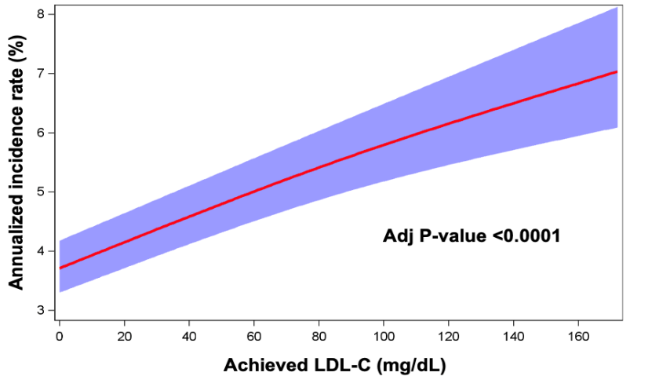
CV Outcomes and Achieved LDL-C
Primary endpoint: CV death, MI, stroke, coronary revascularization or hospitalization for unstable angina
Gaba P et al. AHA 2022

Slide 34
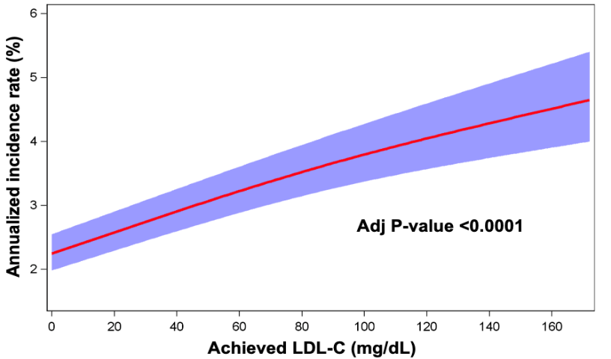
CV Outcomes and Achieved LDL-C
Key secondary endpoint: CV death, MI, or stroke
Gaba P et al. AHA 2022

Slide 35

Safety and Achieved LDL-C
Serious Adverse Events
Muscle-related Events
New Onset Diabetes Mellitus
Cataract-related Adverse Events
Adj P_{trend} = 0.13
Adj P_{trend} = 0.09
Neurocognitive Events
Hemorrhagic Stroke
New or Progressive Malignancy
Non-cardiovascular Death
LDL-C Category:
Gaba P et al. AHA 2022

Slide 36
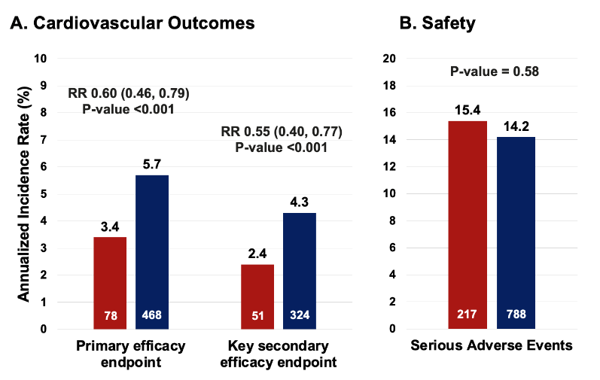
MACE & Safety w/ LDL-C <10 vs ≥100 mg/dL
Gaba P et al. AHA 2022

Slide 37
Limitations
All patients enrolled in FOURIER had stable ASCVD with baseline LDL-C ≥70 mg/dL and non-HDL ≥ 100 mg/dL on GDMT, and thus findings may not be applicable to all patients in general practice
Comparisons based on a post-randomization variable and, despite multivariable analysis, may be subject to residual confounding
Gaba P et al. AHA 2022

Slide 38
Summary & Conclusions
Monotonic relationship between lower achieved LDL-C levels, down to very low LDL-C levels <20 mg/dL, and a lower risk of cardiovascular events up to 8.6 years of follow-up
No serious safety concerns with low LDL-C during the extended follow up period
Altogether, these data suggest that targeting a very low LDL-C level is both effective and safe for patients with atherosclerotic cardiovascular disease
Gaba P et al. AHA 2022

